Slide 1
INTRODUCTORY PROGRAMMING AND PROBLEM SOLVING
WEEK 1
TUTORIAL
BHISMA RAJ KOIRALA

Slide 2
Agenda
Navigation
Agenda
Logical Thinking Ideas
A methodological approach
Algorithm
Pseudo-Code
Flowchart
Flow of Control
Exercises

Slide 3
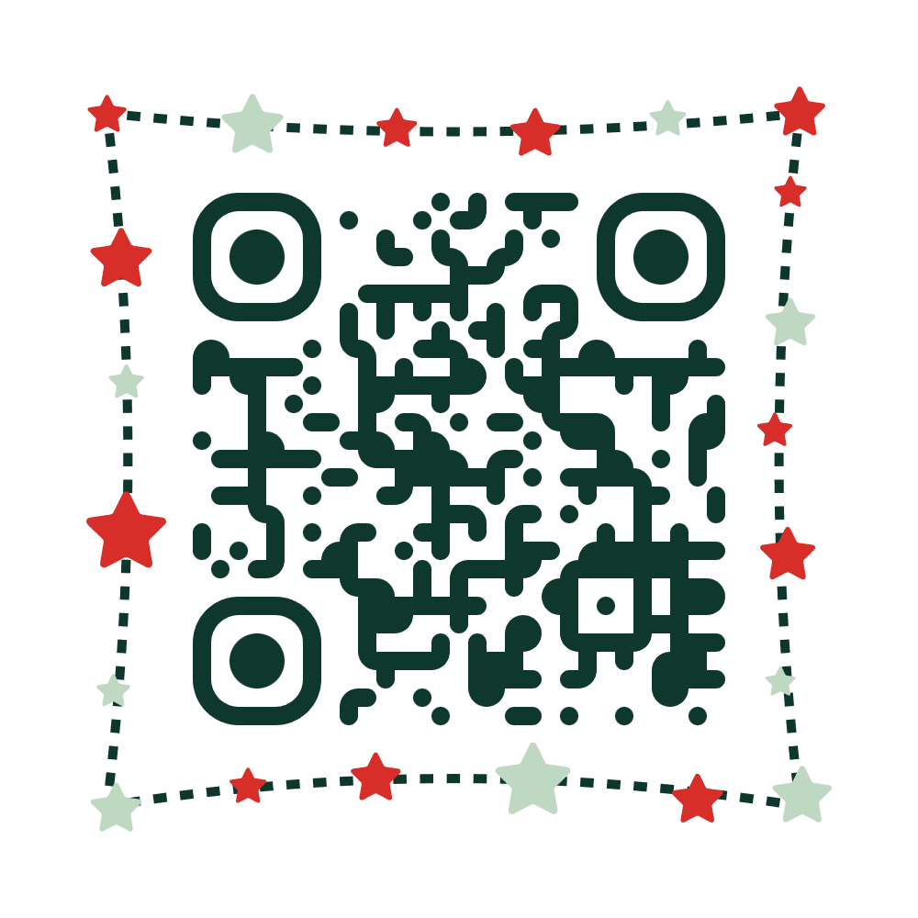

Let’s think logically
Navigation
Agenda
How to start
Let’s play the game
https://www.proprofsgames.com/wolf-sheep-and-cabbage/

Slide 4
Logical thinking ideas
Navigation
Agenda
How to start
Scenario based problem
[Scenario]:
Imagine hearing a sound of water dripping from faucet and realize that there is a leaky faucet at home.
May be at first we will try to fix the problem by our own but incase the problem cannot be solved by us, then we simply turn off the water and call the plumber.
The plumber will analyse the problem to identify the source of water leakage, make a plan about the work to fix the water leakage and fix it.
From above example, it is explicit that, finding a solution to a problem might consist of multiple steps.
For simpler problems we can easily find a solution but complex problems requires a methodical approach.
In programming also, we follow steps for problem solving

Slide 5
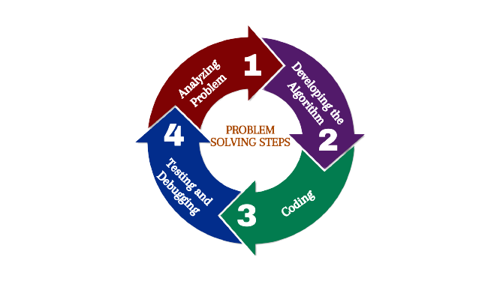
A methodological approach
Navigation
Agenda
How to start
Scenario based problem
A methodological approach
As discussed earlier, easy problem could be easily solved but for complex problems we need to follow methodological approach. In computer science, methodological approach follows four steps:
Remember: It is good practice to develop algorithm before jumping into coding.

Slide 6

Let’s learn and implement

Slide 7
Algorithm
Navigation
Agenda
How to start
Scenario based problem
A methodological approach
Algorithms
What is an Algorithm?
An algorithm is a finite number of clearly described steps that can be followed to produce a desired result for a given input in a finite amount of time (that is, it eventually terminates)
In other words, An algorithm is any well defined computational procedure that takes some values and produce some output
An algorithm helps in achieving input/output relationship

Slide 8
Characteristics of a good algorithm
Navigation
Agenda
How to start
Scenario based problem
A methodological approach
Algorithms
Characteristics of Good Algorithms
Precision – the steps are precisely stated or defined.
Uniqueness – results of each steps are uniquely defined and only depends on the input and the result of the preceding steps.
Finiteness – the algorithm must stop eventually.
Input – the algorithm receives some input.
Output – the algorithm produces desired output.
Processing or computation
Desired Output
User Input

Slide 9
Example -1
Navigation
Agenda
How to start
Scenario based problem
A methodological approach
Algorithms
Characteristics of Good Algorithms
Example and Exercise
Write an algorithm to find the sum of two numbers.
Step 1: Start
Step 2: Input two number and store it to num1 and num2
Step 3: Compute num1 + num2 and store it in addition
Step 4: Display addition
Step 5: End

Slide 10
For You
Navigation
Agenda
How to start
Scenario based problem
A methodological approach
Algorithms
Characteristics of Good Algorithms
Example and Exercise
Write an algorithm to compute square of a number
Step 1: Start
Step 2: Input a number and store it to num1
Step 3: Compute num1* num1 and store it in square
Step 4: Display square
Step 5: End

Slide 11
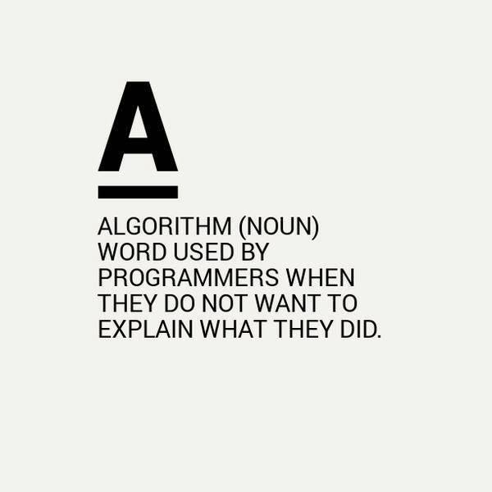

Slide 12
Pseudocode
Navigation
Agenda
How to start
Scenario based problem
A methodological approach
Algorithms
Characteristics of Good Algorithms
Example and Exercise
Pseudocode
A pseudo code is an informal way to describe a program
Pseudo code is not a computer program
Pseudo code can use natural language or mathematical notation
It is a rough sketch of the actual program
Pseudocode begin with a START and ends with END
The algorithm goes in between.
You will need to DECOMPOSE the problem set in the question to work out what comes in between
Pseudocode and their statements
START
……………………………
END

Slide 13
Pseudocode Keywords
Navigation
Agenda
How to start
Scenario based problem
A methodological approach
Algorithms
Characteristics of Good Algorithms
Example and Exercise
Pseudocode
Pseudocode Keywords
Some of the frequently used keywords while writing pseudo-code:
INPUTS:
READ
OBTAIN
GET
INPUT
OUTPUTS:
PRINT
DISPLAY
SHOW
OUTPUT
Usually, a programmer will choose one and stick with it throughout their algorithm.

Slide 14
Pseudocode Keywords
Navigation
Agenda
How to start
Scenario based problem
A methodological approach
Algorithms
Characteristics of Good Algorithms
Example and Exercise
Pseudocode
Pseudocode Keywords
Most of the time pseudocode will outline the logical sequence of instructions to be carried out.
Simple processes will often use the key words shown below (like “CALCULATE X*2” or “INCREMENT X by 1)”
You don’t have to always use these words, for example the logic statements such as “Add 1 to x” or “append x to List” are fine too.
Example:
Increment; ++ or +=
Decrement; -- or -=
Compute/ Calculate
IF/ELSE
While
True/ False

Slide 15
Example
Navigation
Agenda
How to start
Scenario based problem
A methodological approach
Algorithms
Characteristics of Good Algorithms
Example and Exercise
Pseudocode
Pseudocode Keywords
Exercise and Example
Write an pseudocode to find the sum of two numbers.
START
SET sum =0
INPUT num1, num2
COMPUTE sum = num1 + num2
PRINT sum
END

Slide 16
Example
Navigation
Agenda
How to start
Scenario based problem
A methodological approach
Algorithms
Characteristics of Good Algorithms
Example and Exercise
Pseudocode
Pseudocode Keywords
Exercise and Example
Write an pseudocode to find the area of rectangle.
START
SET Area_of_Rectangle = 0
INPUT length and breadth
COMPUTE Area_of_Rectangle = length * breadth
PRINT Area_of_Rectangle
END

Slide 17
Flowchart
Navigation
Agenda
How to start
Scenario based problem
A methodological approach
Algorithms
Characteristics of Good Algorithms
Example and Exercise
Pseudocode
Pseudocode Keywords
Exercise and Example
Flowchart
Is a pictorial way to express algorithm or process.
Instead of writing down our algorithm in any programming, we use symbols to express our algorithm which gives us a general view about the algorithm
Flowchart as the name indicates, is about the flow of execution of our algorithm.
There are standardised symbols to draw flowcharts.

Slide 18
Flowchart – Basic Symbols
Navigation
Agenda
How to start
Scenario based problem
A methodological approach
Algorithms
Characteristics of Good Algorithms
Example and Exercise
Pseudocode
Pseudocode Keywords
Exercise and Example
Flowchart Basic Symbols
Flowchart Symbol | Function | Description
 | Start/End | It indicates where the flow starts and ends. Also known as terminator.
 | Process | Also called “Action Symbol,” it represents a process, action or a single step
 | Decision | A decision or branching point, usually a yes/no or true/false question is asked and based on that, the path gets split into two branches
 | Input/ Output | Also called as data symbol, this parallelogram shape is used to input or output data.
 | Arrow | Line Connector to show the flow between shapes.

Slide 19
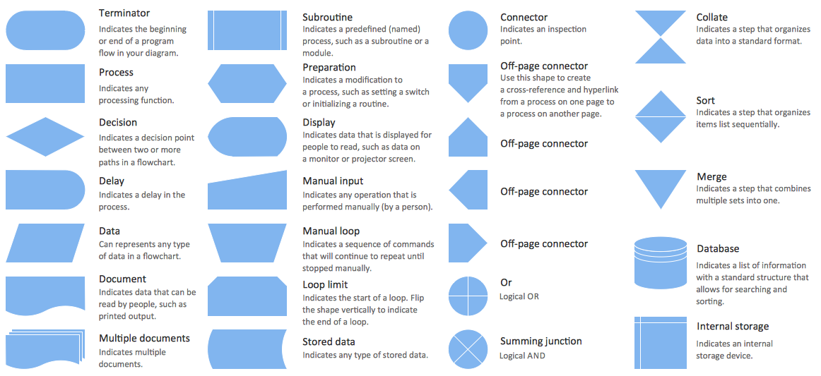
Navigation
Agenda
How to start
Scenario based problem
A methodological approach
Algorithms
Characteristics of Good Algorithms
Example and Exercise
Pseudocode
Pseudocode Keywords
Exercise and Example
Flowchart
Flowchart Basic Symbols
Flowchart Advanced Symbols

Slide 20
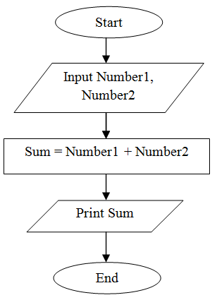
Example
Navigation
Agenda
How to start
Scenario based problem
A methodological approach
Algorithms
Characteristics of Good Algorithms
Example and Exercise
Pseudocode
Pseudocode Keywords
Exercise and Example
Flowchart Basic Symbols
Flowchart Advanced Symbols
Example and Exercise
Draw a flowchart of the sum of two numbers

Slide 21
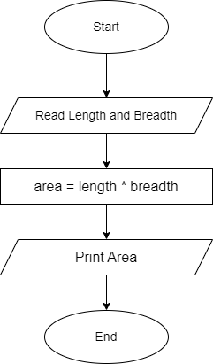
Exercise
Navigation
Agenda
How to start
Scenario based problem
A methodological approach
Algorithms
Characteristics of Good Algorithms
Example and Exercise
Pseudocode
Pseudocode Keywords
Exercise and Example
Flowchart Basic Symbols
Flowchart Advanced Symbols
Example and Exercise
Draw a flowchart of the area of rectangle

Slide 22
Flow of Control
Navigation
Agenda
How to start
Scenario based problem
A methodological approach
Algorithms
Characteristics of Good Algorithms
Example and Exercise
Pseudocode
Pseudocode Keywords
Exercise and Example
Flowchart Basic Symbols
Flowchart Advanced Symbols
Example and Exercise
Flow of Control
As previously discussed, the flow of control depicts the flow of events as represented in the flow chart.
The events can flow in a sequence, or on branch based on a decision or even repeat some part for a finite number of times.
Such flow of control is denoted as sequence, selection and repetition

Slide 23
Flow of Control-Sequential
Navigation
Agenda
How to start
Scenario based problem
A methodological approach
Algorithms
Characteristics of Good Algorithms
Example and Exercise
Pseudocode
Pseudocode Keywords
Exercise and Example
Flowchart Basic Symbols
Flowchart Advanced Symbols
Example and Exercise
Flow of Control
Flow of Control -Sequential
Begin
Statement 1
Read birth date
Statement 2
Calculate
Age = current year – birth date
Statement 3
Display
age
:
End

Slide 24
Flow of Control
Navigation
Agenda
How to start
Scenario based problem
A methodological approach
Algorithms
Characteristics of Good Algorithms
Example and Exercise
Pseudocode
Pseudocode Keywords
Exercise and Example
Flowchart Basic Symbols
Flowchart Advanced Symbols
Example and Exercise
Flow of Control
Flow of Control –Sequential
Flow of Control –Selection
Flow of Control -Repetative
Begin
No
Yes
Read age
Condition
YES
Age > 55?
NO
else-
statement(s)
then-
statement(s)
print “Non-pension”
print “Pension”
End

Slide 25
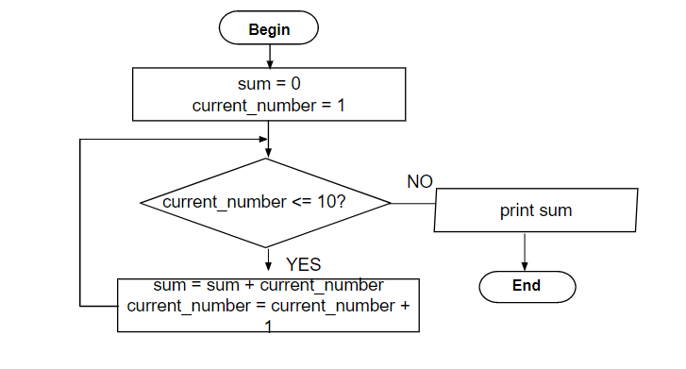
Flow of Control
Navigation
Agenda
How to start
Scenario based problem
A methodological approach
Algorithms
Characteristics of Good Algorithms
Example and Exercise
Pseudocode
Pseudocode Keywords
Exercise and Example
Flowchart Basic Symbols
Flowchart Advanced Symbols
Example and Exercise
Flow of Control
Flow of Control –Sequential
Flow of Control –Selection
Flow of Control -Repetative
yes
Loop
Statement(s)
Condition
no

Slide 26
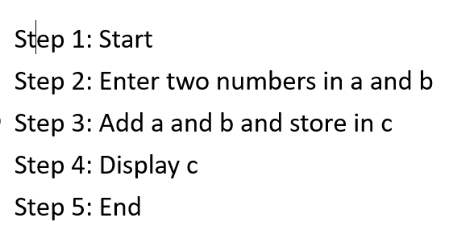
Using Algorithm and Flowchart in Coding
Navigation
Agenda
How to start
Scenario based problem
A methodological approach
Algorithms
Characteristics of Good Algorithms
Example and Exercise
Pseudocode
Pseudocode Keywords
Exercise and Example
Flowchart Basic Symbols
Flowchart Advanced Symbols
Example and Exercise
Flow of Control
Flow of Control –Sequential
Flow of Control –Selection
Flow of Control –Repetitive
Using Algorithm and Flow Chart
Example
# Prompt the user to enter the first number
num1 = float(input("Enter the first number: "))
# Prompt the user to enter the second number
num2 = float(input("Enter the second number: "))
# Add the two numbers together
result = num1 + num2
# Print the result to the user
print(f"The sum of {num1} and {num2} is {result}”)

Slide 27
Exercise for You
Navigation
Agenda
How to start
Scenario based problem
A methodological approach
Algorithms
Characteristics of Good Algorithms
Example and Exercise
Pseudocode
Pseudocode Keywords
Exercise and Example
Flowchart Basic Symbols
Flowchart Advanced Symbols
Example and Exercise
Flow of Control
Flow of Control –Sequential
Flow of Control –Selection
Flow of Control –Repetative
Using Algorithm and Flow Chart
Exercise and Example
Write an pseudocode and flowchart that will accept/read two numbers and then display the bigger number.
Write an pseudocode and flowchart to find whether the number is even or not.
Write a pseudocode and draw a flowchart to check whether a person is either child or teenage or adult. (Hint: child(<13), teenager(>=13 but <20) or adult(>=20)).
Create an algorithm and a flowchart that will compute the sum of two numbers. If the sum is below or equal to twenty, two number will be entered again. If the sum is above 20, it will display sum.

Slide 28
Homework for You
Navigation
Agenda
How to start
Scenario based problem
A methodological approach
Algorithms
Characteristics of Good Algorithms
Example and Exercise
Pseudocode
Pseudocode Keywords
Exercise and Example
Flowchart Basic Symbols
Flowchart Advanced Symbols
Example and Exercise
Flow of Control
Flow of Control –Sequential
Flow of Control –Selection
Flow of Control –Repetative
Using Algorithm and Flow Chart
Exercise and Example
Assignments
Create an algorithm and a flowchart that will output the factorial of a given number.
Create an algorithm and a flowchart that will output the Fibonacci series up to a given number.
Create an algorithm and a flowchart that will output all the prime numbers between 2 numbers.

